Slide 1

Reinforcement Learning in
Azure Machine Learning
Keiji Kanazawa
Azure Machine Learning

Slide 2
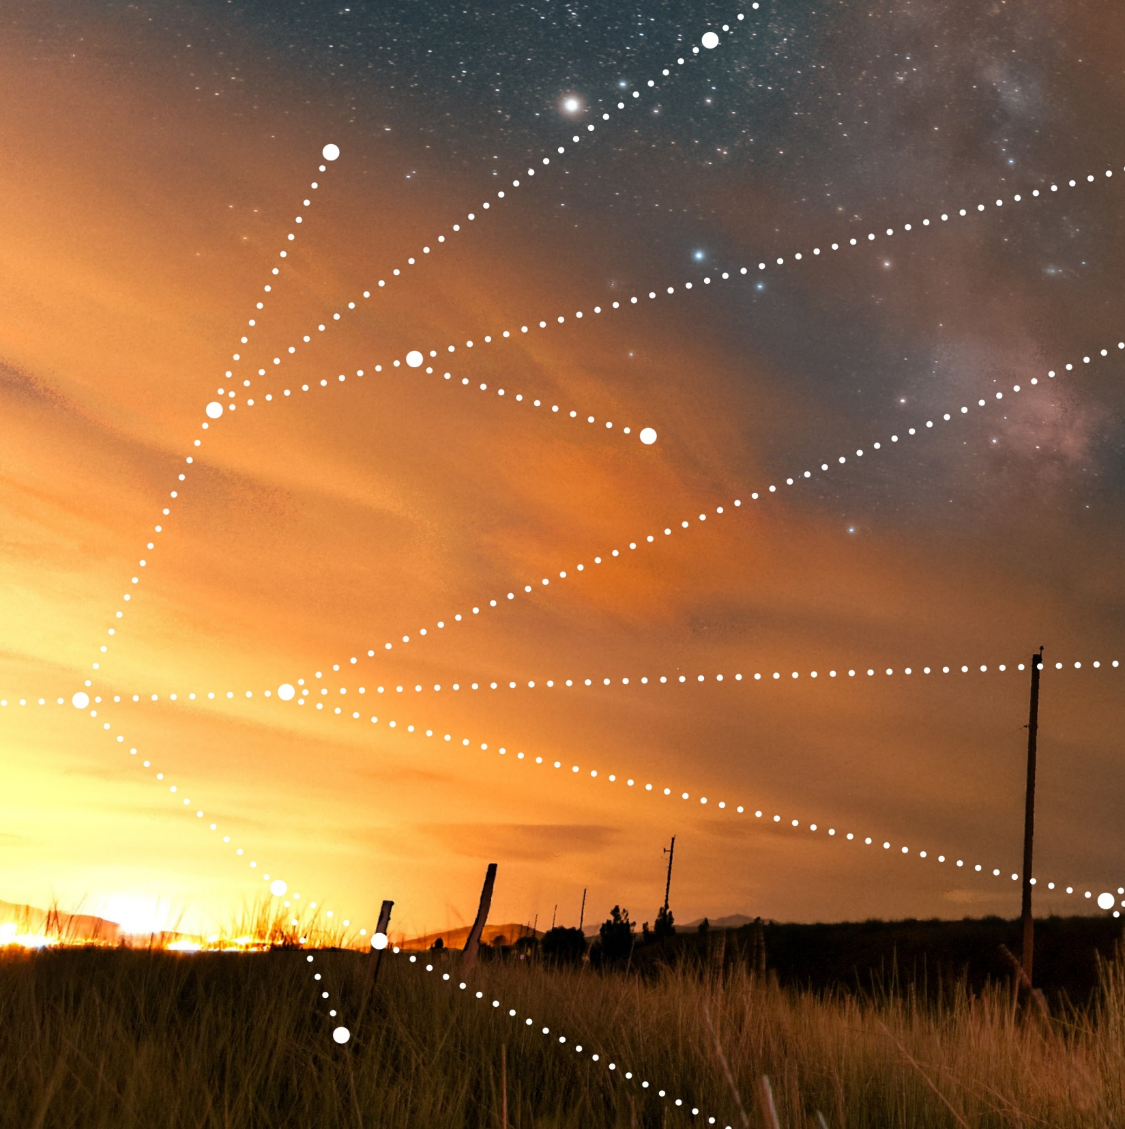
Agenda
RL: What / Why / Who?
RL in Azure Machine Learning

Slide 3

What is RL?
Act
Learn from interactions with the world
Observe
Act
Get reward
Repeat
Goal: maximize expected rewards
RL Agent
Observe

Slide 4
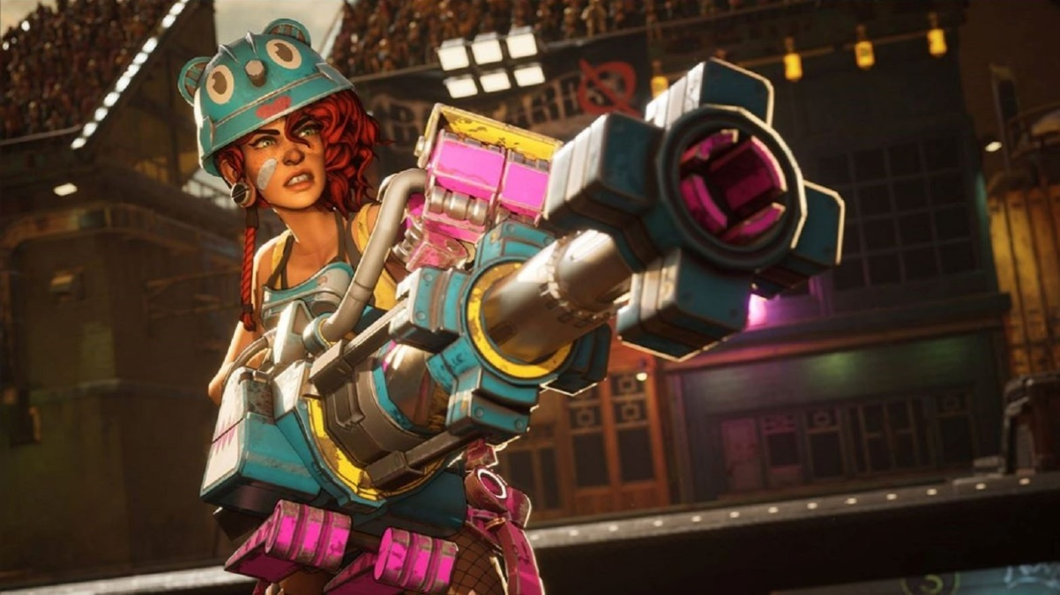
Gaming

Slide 5







Real Customer Problems
System Optimization & Control
Resource & Operations Optimization
Adaptive Experiences
Gaming
Energy and Grid Optimization
Logistics & Transport
Healthcare
Content Personalization
Industrial Control - Robotics
Knowledge Worker Augmentation
Computer Security
Fraud & Risk Management

Slide 6

Reinforcement Learning in Microsoft
Azure
Azure Machine Learning
Distributed Agent Training
Azure Cognitive Services
Personalization Service
Azure Global
Logistics
Autonomous Systems
Project Bonsai: AI for Industrial Control
Reinforcement Learning In Simulators
Language for Machine Teaching
Athens
AI for Game Developers
Sample efficient multi-step RL – enabled by player data, privileged game engine access
Project Paidia
Open Source
Vowpal Wabbit: Contextual Bandits, learning to search, Online Learning Workbench.
AirSim: Unity-based simulation engine for drones, vehicles, etc.
Contributions to Ray/RLLib
Customer Facing Products
Microsoft Research
Applications
Algorithms
RL Theory
Shared Goals:
Agile Delivery of Innovations
Cross-pollination of research + customers
Design Platforms to stream innovations
Enable “research in production” cloud sandboxes
Attract Research & Industry Talent
Cross-linked Research and Product presence
Researchers see impact
Engineers see coolness
Coherent Customer Messaging
Common RL Messaging & Positioning Framework
Common Branding storybook across MSR and Prod
Cross- and up-sell across customer facing products

Slide 7
Agenda
RL: What / Why / Who?
RL in Azure Machine Learning

Slide 8
Demo

Slide 9
Customer Example

Slide 10

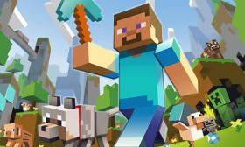
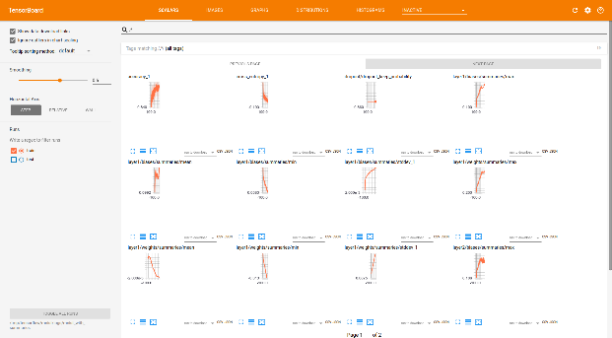
How It Works
Azure Machine Learning
Ray Cluster
Simulator Cluster
Head Node (Training)
Data Scientist Submits Experiment
Worker Node
Simulator Node
Worker
Worker
Sim
Sim
Worker Node
Simulator Node
Worker
Worker
Sim
Sim
Training Results

Slide 11
Customers
Dow
Chevron
Schindler IT
Azure Global
COSINE
MSR + Gaming
Xbox Store

Slide 12




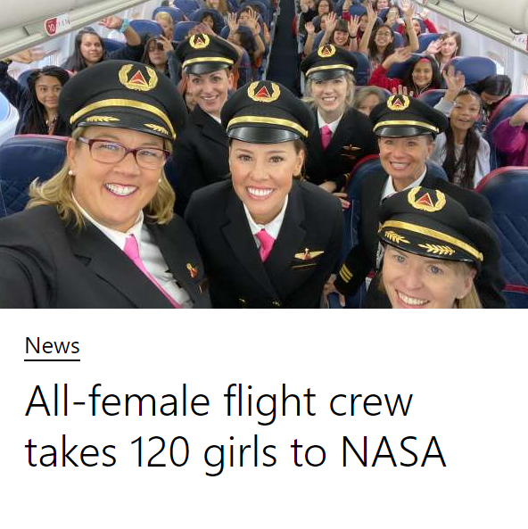
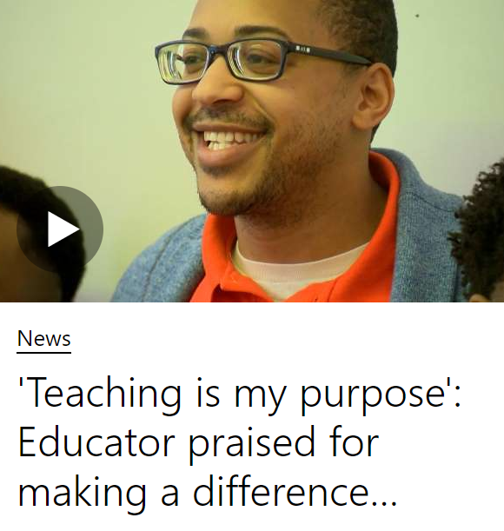
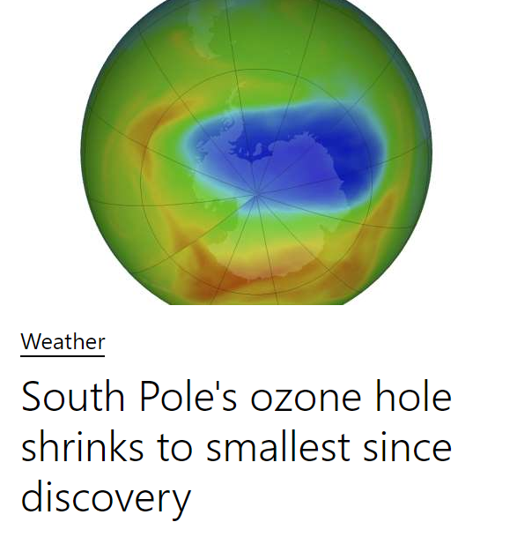


Contextual Bandit RL: Customization
Simple Developer Experience
Powerful Data Science
Context: Information About Each User + Environment
Cognitive Services Personalizer
Azure
Machine
Learning
Deploy to Personalizer
Users interacts with application /site.
Actions: Articles to Choose from
Data Scientist runs experiments to optimize model
Each user reacts to the displayed choice.
Reward Score(s)
Generated by customers from desired KPIs
Azure AI Platform
Data Scientist analyzes interaction data
Azure

Slide 13
Resources
GitHub: https://aka.ms/azureml-rl-notebooks
Documentation: https://aka.ms/amlrl-doc
Video: https://aka.ms/azureml-rl-aishow
Blog: https://aka.ms/azureml-rl
GameStack Live blog: https://aka.ms/GSLAIblog
GameStack Live video: https://aka.ms/gslaivideo
Project Paidia: https://innovation.microsoft.com/en-us/exploring-project-paidia
Minerl competition: https://minerl.io/competition/

Slide 14
Contacts
Keiji Kanazawa: keijik
Dan Sommerfield: dasommer

Slide 15

Thank You

